Slide 1
Activation Plateaus
Meeting Slides
Francisco Ferreira da Silva, Arnau Marin-Llobet and Stefan Heimersheim

Slide 2
Meeting 27/02/2026 - Contents
Today:
1. Plateau-ness degrades away from real activations
2. Cross-group feature composition
3. Jacobian optimizations
4. Quantitative model for plateau-breaking angles
5. ChessGPT: three-regime validation
6. Subspace scaling — 25 features
7. Feature refinement + progressive discovery (~140 features)
8. Subspace scaling — 135 features with variable thresholds
9. Feature reconstruction
10. Discussion / next steps

Slide 3
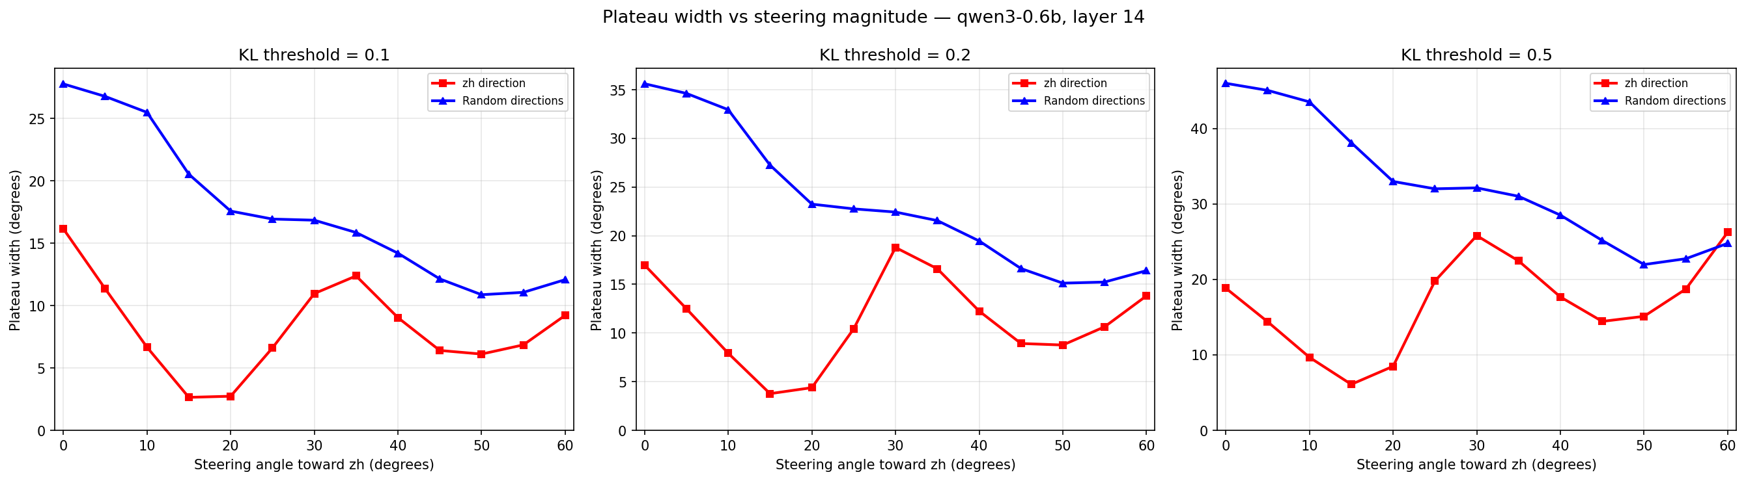
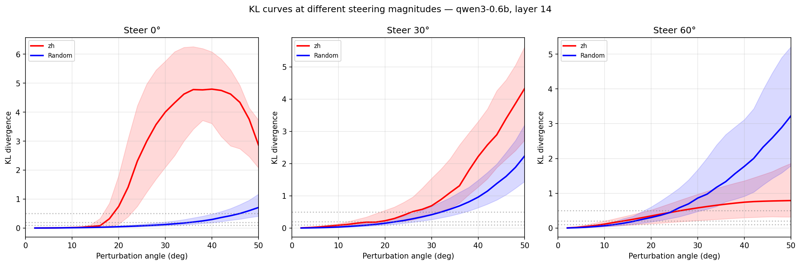
Plateau-ness degrades away from real activations
• Steer at increasing magnitudes, measure plateau width → plateau shrinks

Slide 4
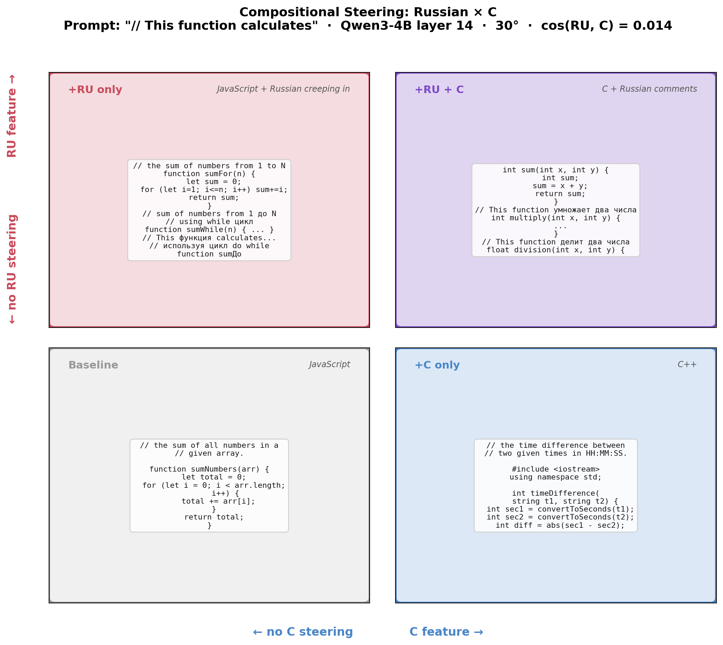
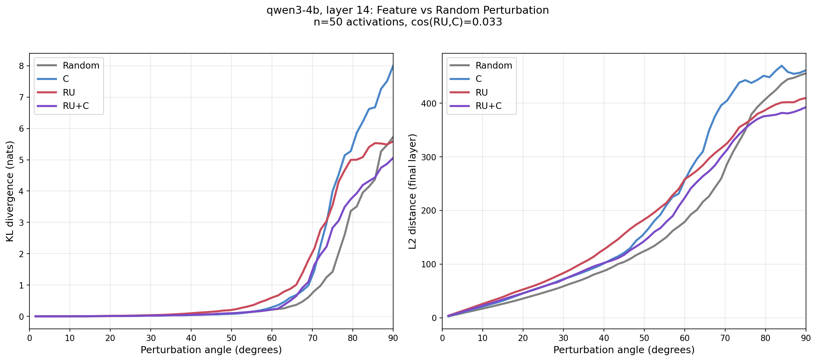
Cross-group feature composition
• Russian + C = Russian C. Scaling monotonic but weak
• Methodological note: must include dominant language in multi-contrastive set

Slide 5
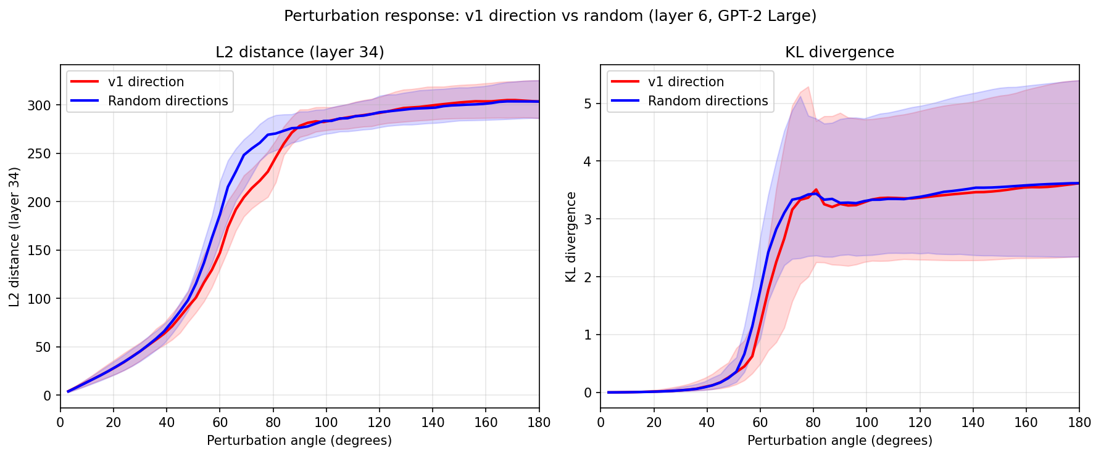
Jacobian Optimizations
• Approach: optimize for directions that minimize Jacobian norm of resulting activations
• Result: found directions producing real-ish activations with plateaus
• But: perturbation plots along these directions look random (right)
• Steering: minimal changes, then model breaks down
• Conclusion: optimizers can find directions producing similar activations that aren't features

Slide 6
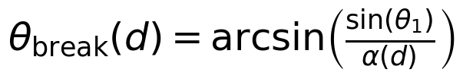

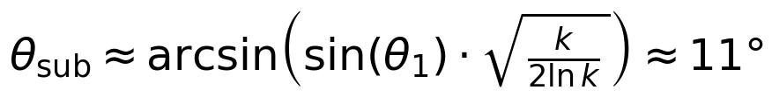
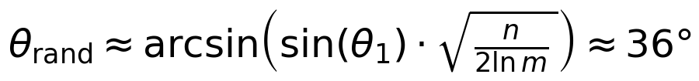
Quantitative model for plateau-breaking
• Key equation:
where α(d) = max alignment of d with any feature
• Three predictions:
1. Single feature:
2. Random in k-dim subspace:
3. Fully random:
• Details in the shared write-up

Slide 7
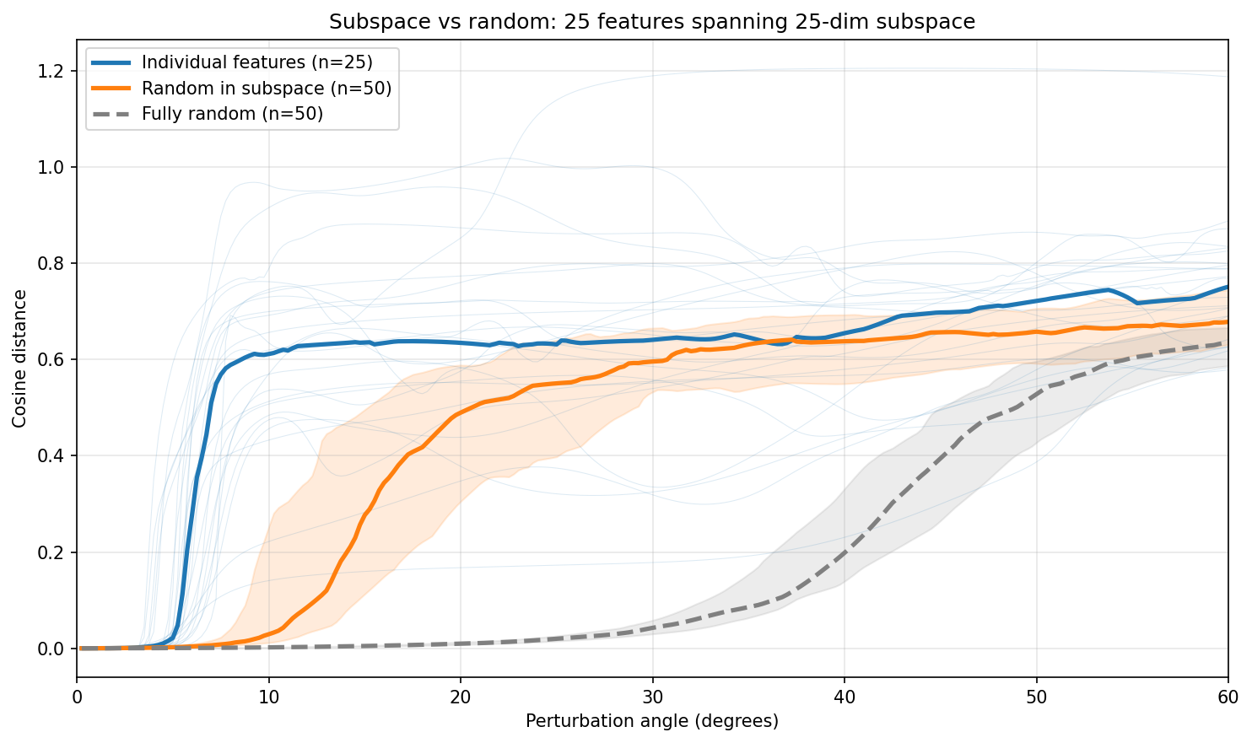
ChessGPT: three-regime validation
Observed vs predicted:
• Features: ~5.5°
• Subspace random: ~12.5° (pred: 11°)
• Fully random: ~36.3° (pred: 36°, m≈1000)

Slide 8
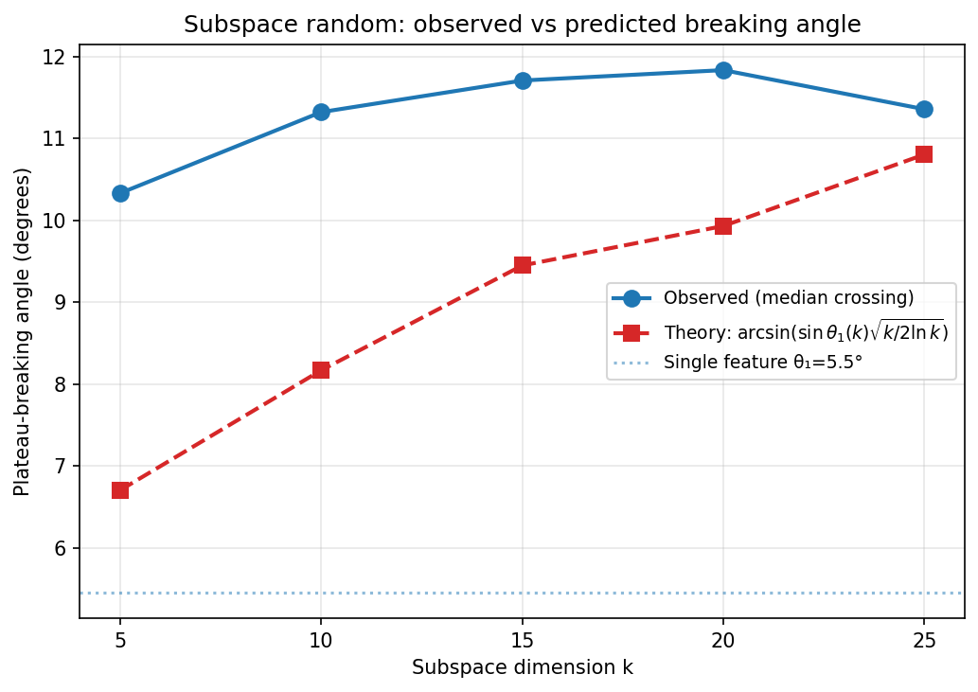
Subspace scaling — 25 features
• Directionally correct, underpredicts by 20–30%
• Two confounders:
1. Dirty features (rotated from true features)
2. Variable θ₁ per feature (model assumes uniform)

Slide 9
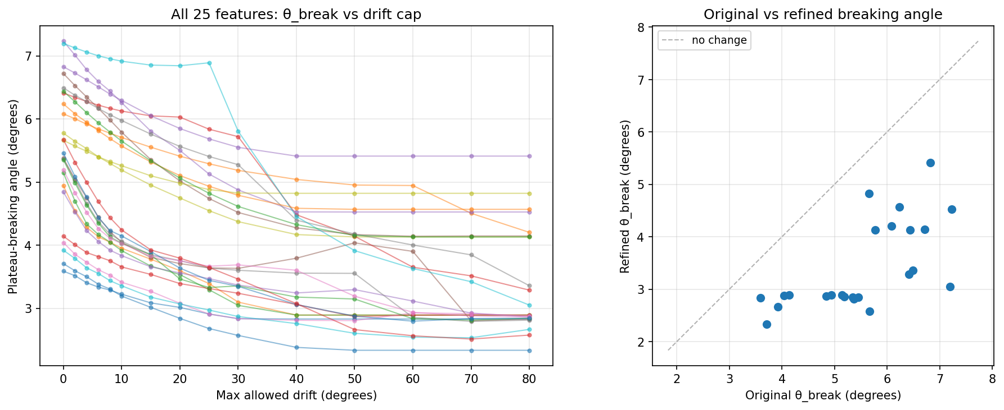
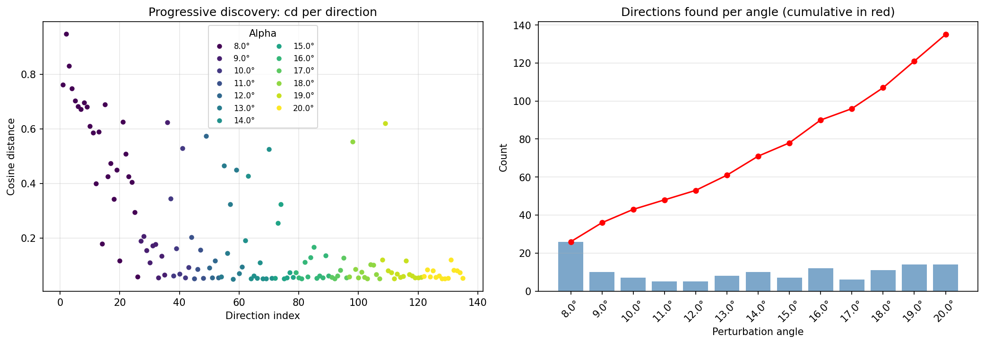
Feature refinement + progressive discovery
• Local optimization cleans features. θ₁ range: 2.2–5.5°
• Progressive MELBO: ~140 features in 512-d space

Slide 10
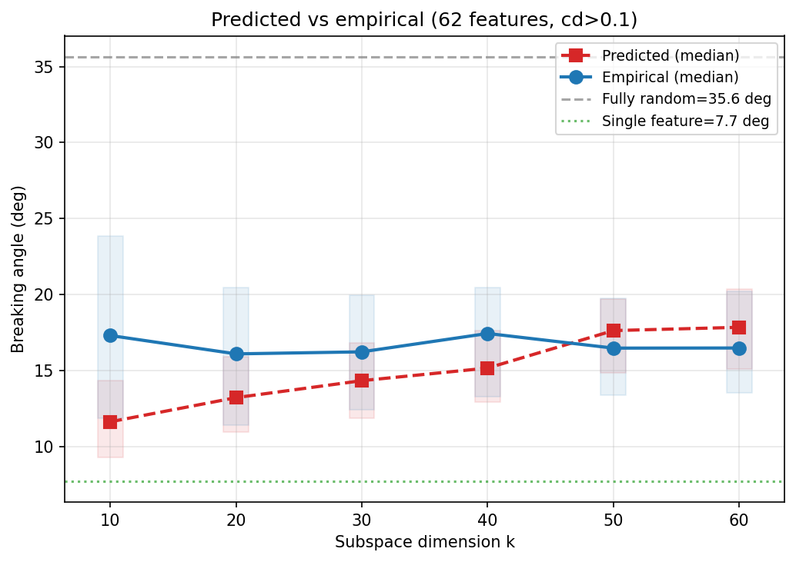
Subspace scaling — 135 features, variable thresholds
• Predicted trend increases, empirical is flat
• Error bars overlap but trends disagree
• Current status

Slide 11
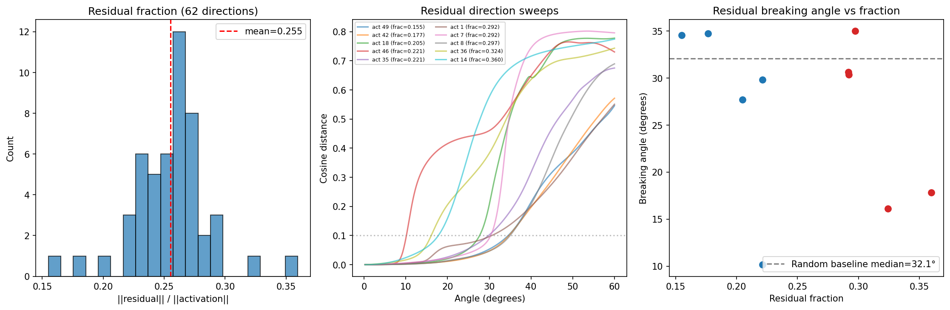
Feature reconstruction
• 62 directions explain 93.4% variance. Top 3 explain 83%
• Most residual plateau-breaking angles close to random baseline, but some outliers
• Outliers suggest we can extract more features from residuals
• d₁ correlates r > 0.96 with move count

Slide 12
Discussion / next steps
• Reference research directions document
• What's prioritized, what's open for discussion

Slide 13
Meeting 19/02/2026 - Contents
Last time: Feature directions (PC1/MELBO₁) break plateaus while the nearly-identical mean direction does not
Today: Things I've done that I'd like to cover:
Solution to the above puzzle
  Not so exciting; I was steering the mean in the wrong direction lol
Steering lines up nicely with perturbation sweep
Multi-contrastive steering: can we estimate feature vector rather than difference-of-means?
Adapted MELBO: selecting for feature-like response profiles

Slide 14
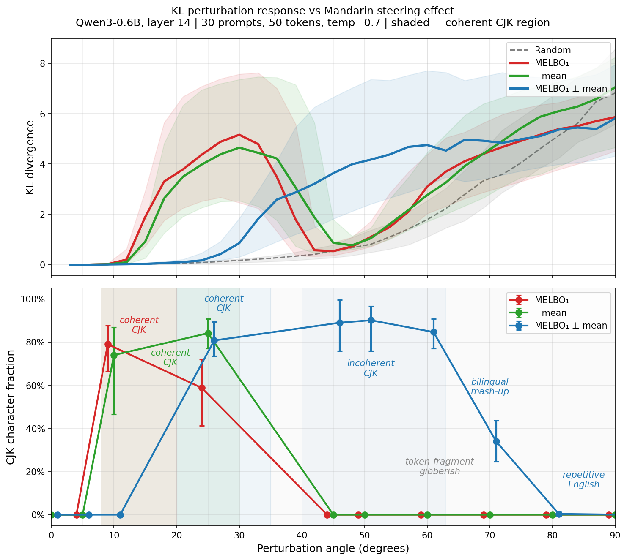
Steering and Perturbation Line Up
Top: perturbation sweep KL-div (sorry)
Bottom: steering effectiveness as fraction of CJK characters starting from English prompt
Component of MELBO_1 that's orthogonal to mean also steers, but in a different regime
Component of mean orthogonal to MELBO_1 does nothing

Slide 15
Multi-contrastive steering/feature isolation
Diff-of-means gives you vector between two concepts, not the concepts' vectors d_EM = mean(EN) - mean(ZH) \approx f_EN - f_ZH
Idea: If we contrast English against many languages, the English component is shared across all differences while the other languages point in other directions and cancel out
Stack them, SVD -> Isolate f_EN

Slide 16
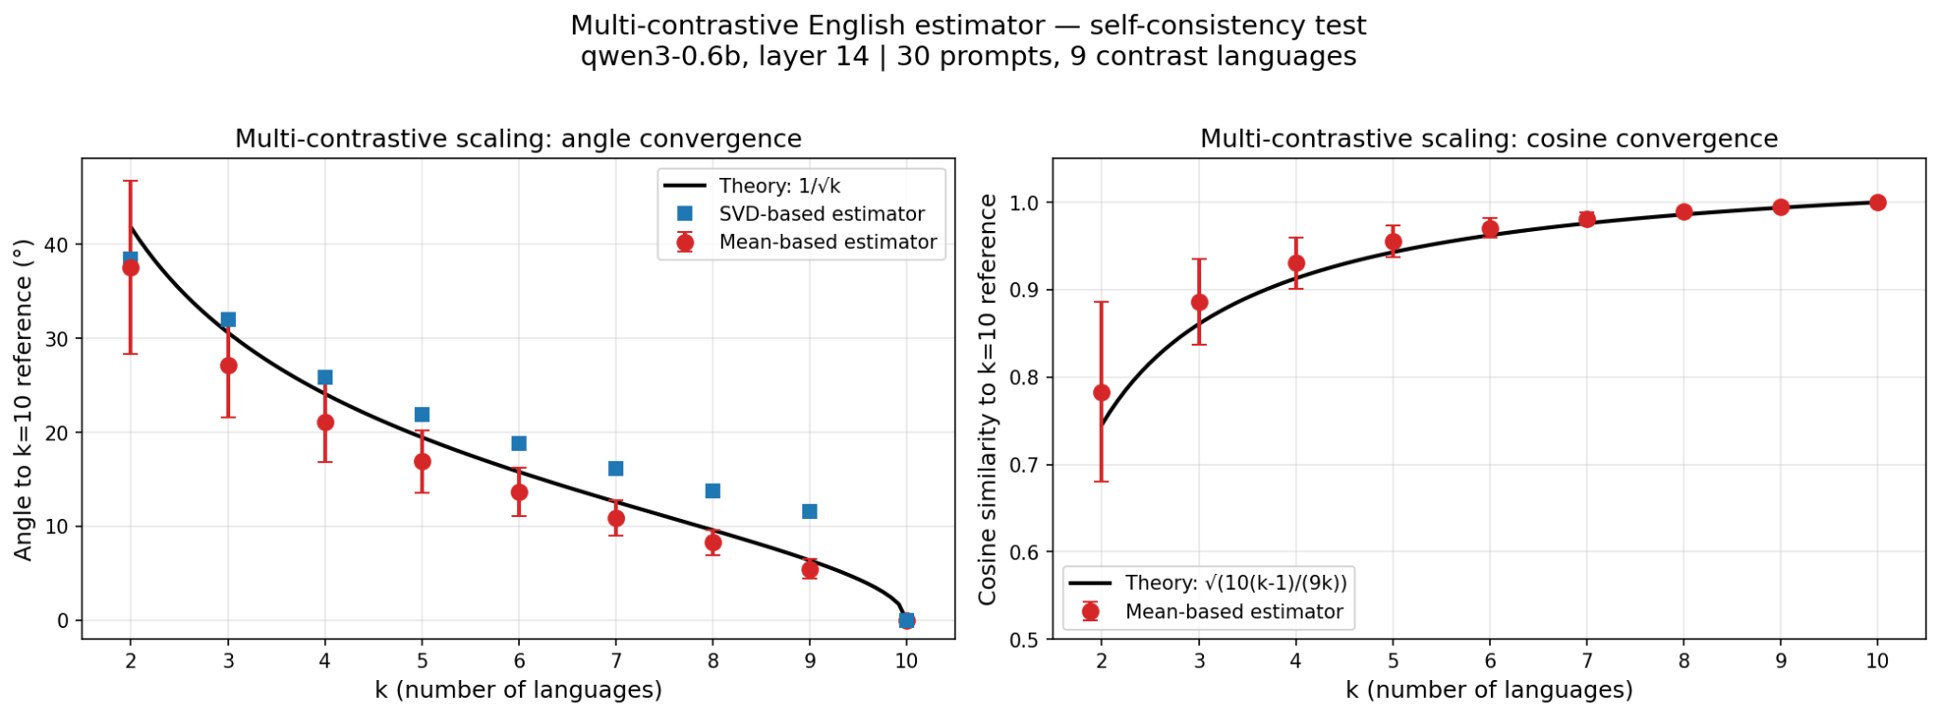
Validation: convergence
Predict convergence as 1/sqrt(k); effectively independent measurements if features orthogonal

Slide 17
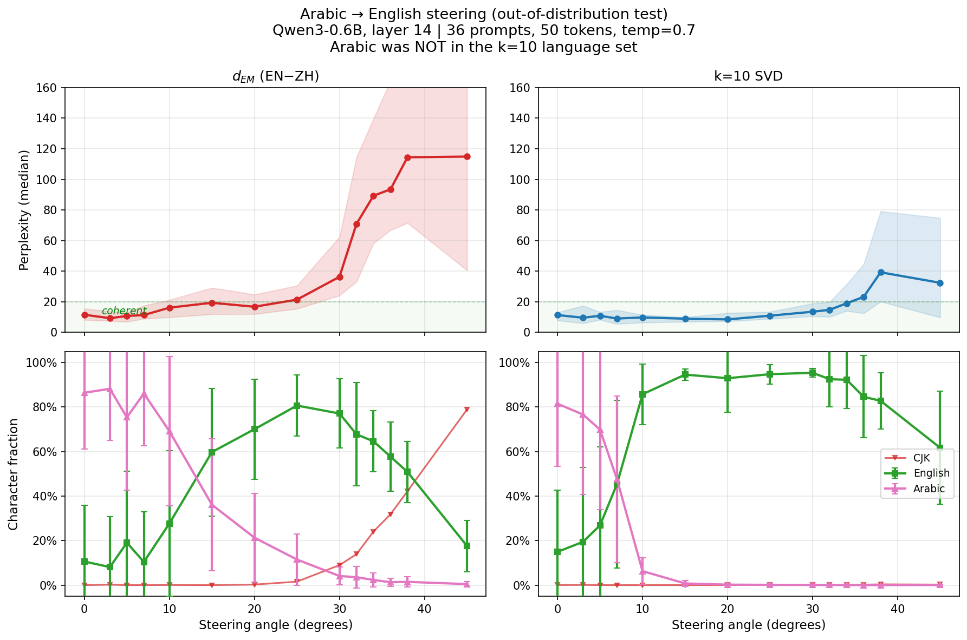
Validation: generalizes to held-out language
Arabic not in k=10
Perplexity as proxy for coherence
Different alphabet -> easy to measure steering effect
Better than diff-of-means
Claim: We have English direction

Slide 18
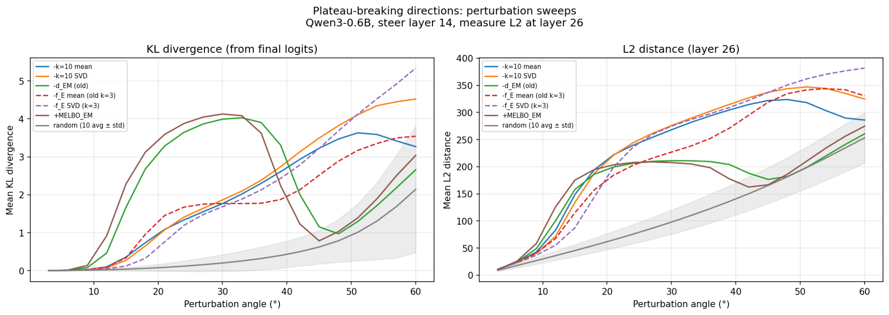
Perturbation sweeps look… smoother?
Pretty linear for quite a range after plateau
Do we want to optimize for this profile?
Note: much less notable in L2?

Slide 19
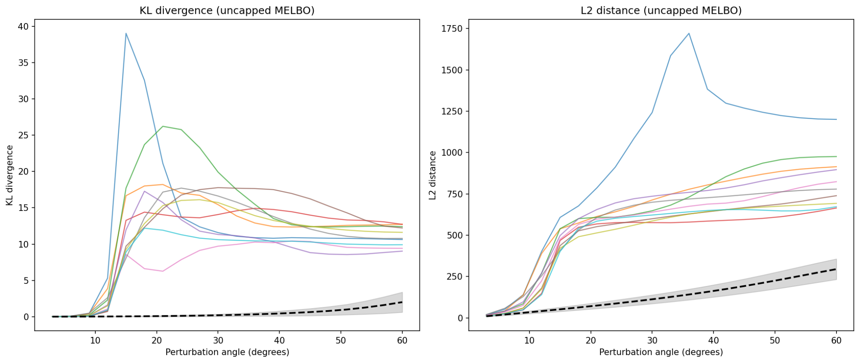
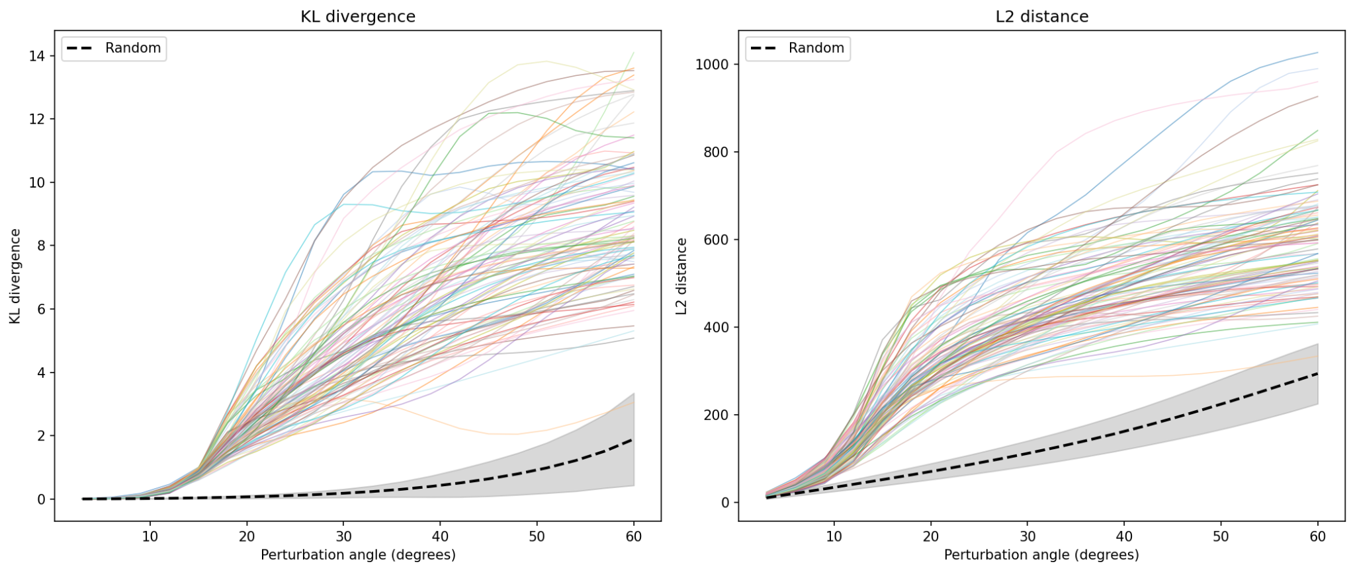
MELBO on diverse dataset
Top: max kl-div; Bottom: profile-matched kl-div
Problem: MELBO directions break the model
Idea: Instead of direction of max perturbation, find direction that breaks off to ~1 KL-div around ~15 degrees (these are hyperparameters)
Quite a few interpretable! Steered with top ~10 and found:
numbers/math-y
Verbosity?
Economics
Academic Publication?

Slide 20
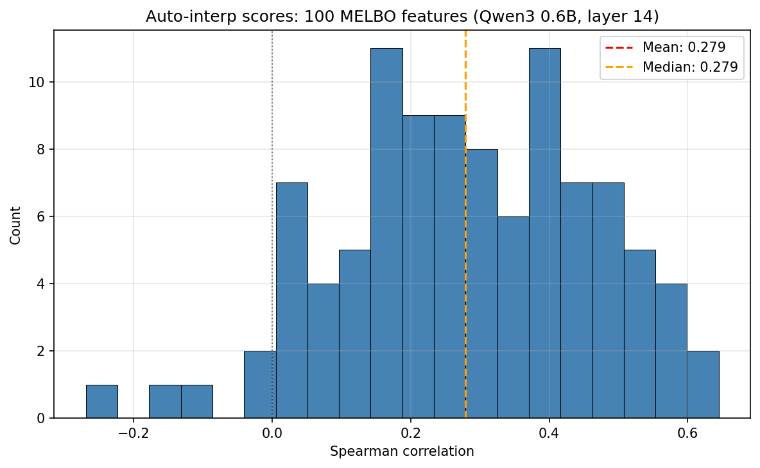
Auto-interp as per Anthropic
Correlate LLM-explainer with LLM-simulator of top-prompts activating directions
Manual check on top few looks decent
Smaller numbers than Anthropic
Probably too little context: 5 tokens vs 128 their experiment

Slide 21
Questions/Directions
How to do interpretability at scale? Steering and looking at results isn't fun for 100 directions… Delegate to LLM? Something else?
Tried to generalize multi-contrastive steering to animals but did not work :-)
MELBO constrained to span of differences of animals/active dataset dogs also did not work
Is this direction interesting? Or should we stick to unconstrained, since we can apparently find features?
Keen on the 'geometry of plateau' direction? Feature radius vs random radius, I mean

Slide 22
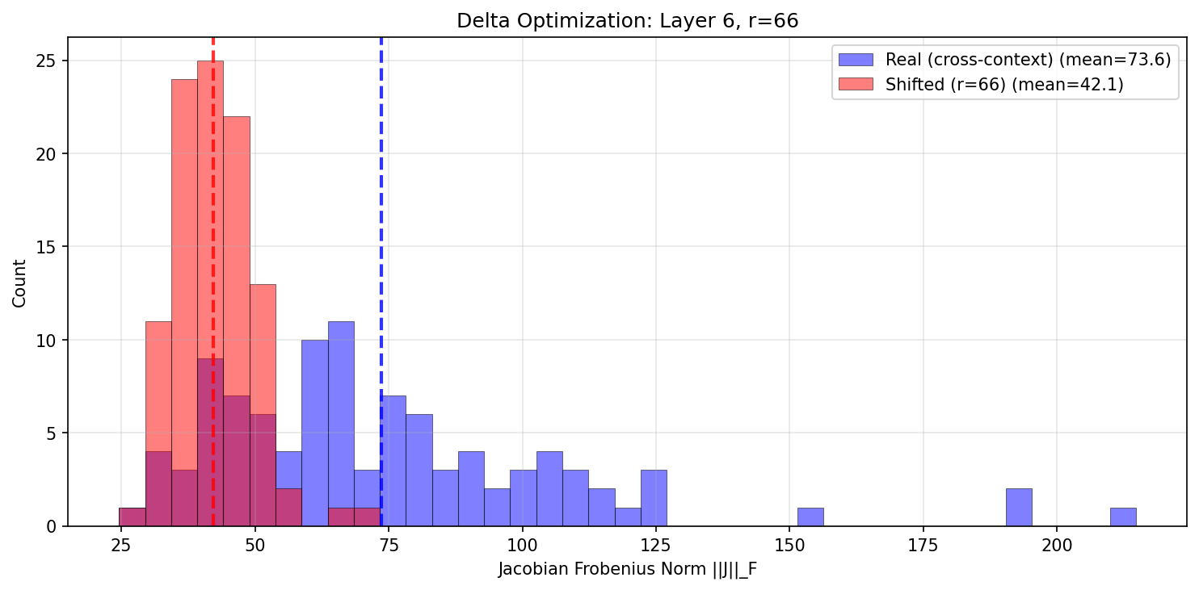
Meeting 12/02/2026 - Summary
Last time: We can optimize for vector taking us from set of real activations to set of activations with small Jacobian norm!
Up next: A few threads proposed:
Do shifted activations have plateaus?
Find steering vector that 'works'. Do resulting activations have plateaus? Follow-up: can we optimize them/the steering vector so that they do?
How does steering compare plateau-wise to perturbing along random direction?

Slide 23
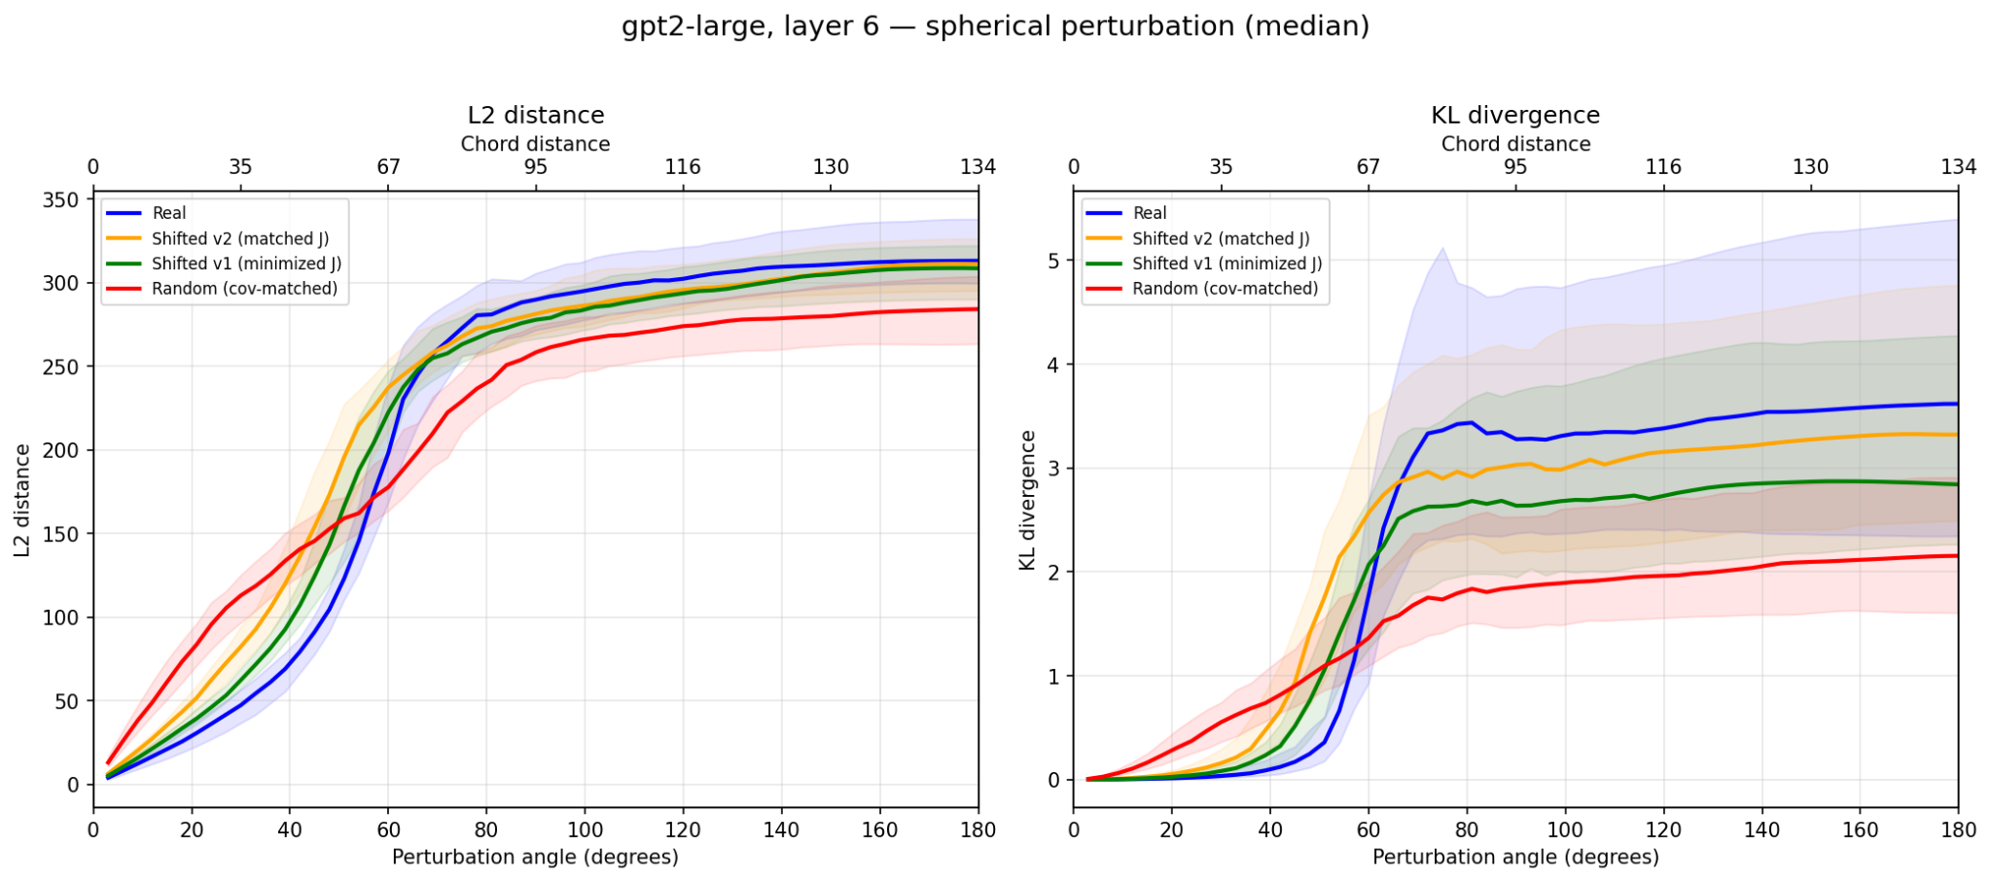
Do shifted activations have plateaus?
Yes! But smaller than real activations. Matching Jacobian norm not enough; minimizing it is better

Slide 24
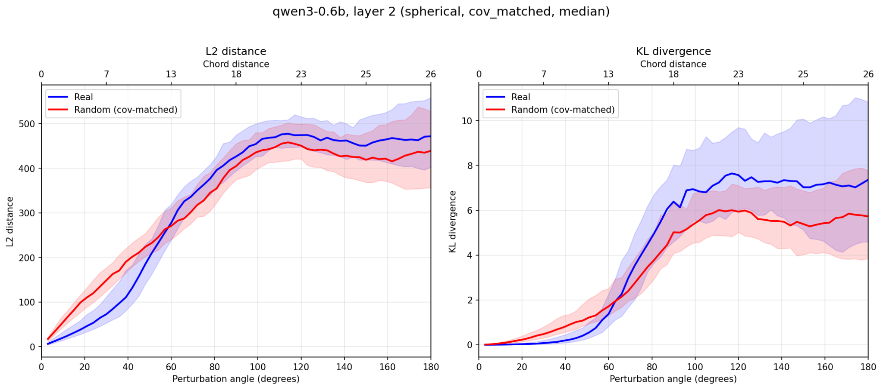
Intermezzo: switched to Qwen3 0.6B
Sanity check: Does it exhibit plateaus?
Aside: Previous mentees of Stefan found no plateaus in Gemma (https://arxiv.org/abs/2409.17113). What's up with that?

Slide 25
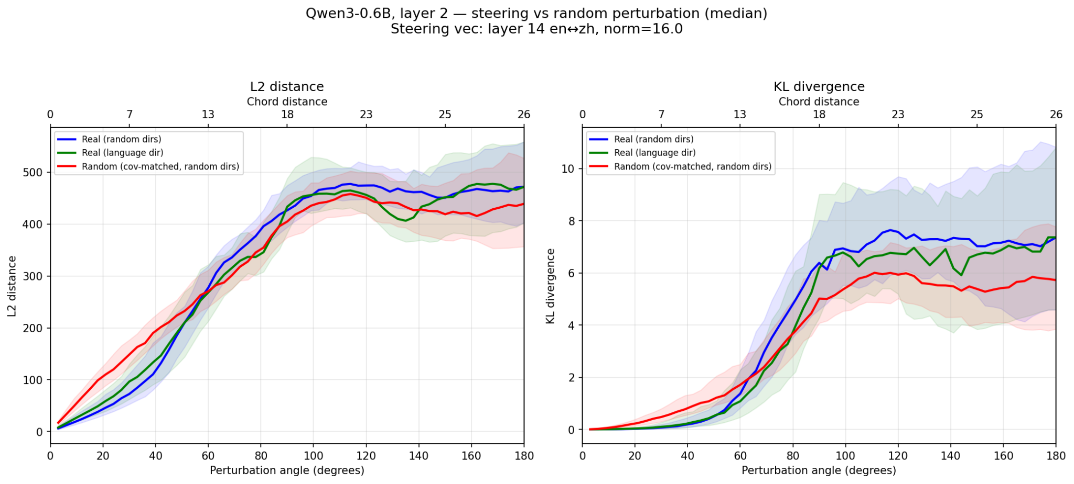
How does steering compare plateau-wise to perturbing along random direction?
Steering direction: difference-of-means English, Mandarin prompts (generated by Claude, I don't speak Mandarin)
Perturb along steering direction; measure impact on later layer… Looks just like random??
Hypothesis: steering vector is not clean feature, but superposition of many features -> random-like
Potential confounder: perturbing at layer 2, extracted vector at layer 14 (but holds also with both at layer 14; see later slide)

Slide 26
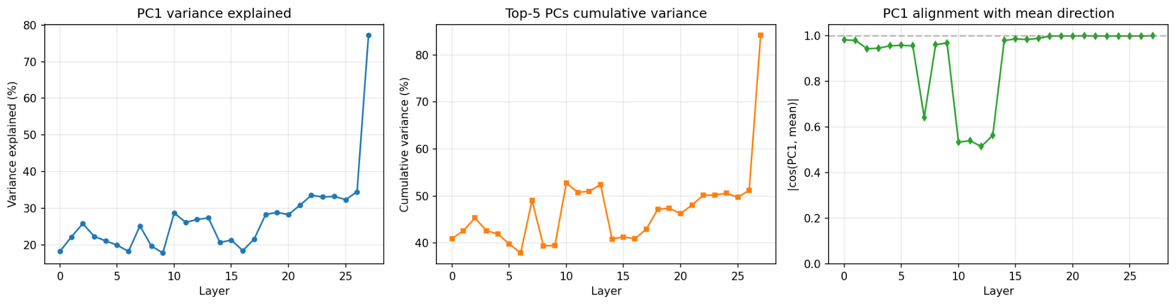
Can we decompose the matrix of differences?
Performed SVD on the matrix of differences at each layer (so stacked vectors of activation differences), checked how much variance is explained by PCs
Dips in mid layers appear to be due to token-length mismatches in some contrastive pairs; removing outliers gets rid of them
At most layers, PC1 extremely aligned with mean; but vector is multidimensional: top PC explains only ~30% of variance

Slide 27
Can we optimize the decomposition of the language steering vector?
Goal: Find the direction *within the span of the difference matrix D* that maximizes KL divergence when used as a spherical perturbation.
Why? This asks: "which component of the language steering vector causes the most behavioral change?"
Note that this is kind of like constrained MELBO.
Fix magnitude of perturbation at 15 angles: guess; still in plateau for random direction, but perhaps not for feature direction

Slide 28
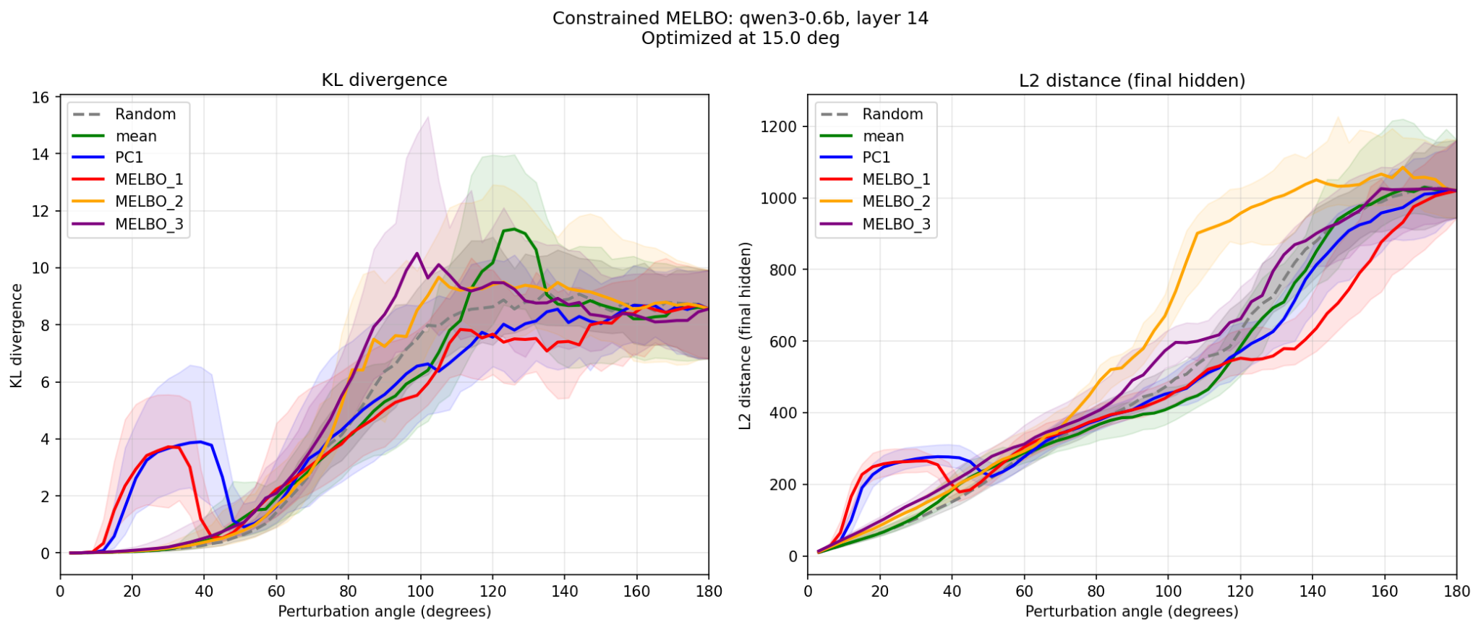
We can, and it breaks the plateau!
So does PC1 - very similar behavior

Slide 29
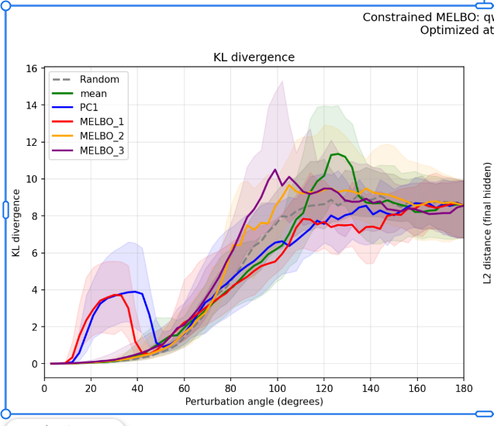
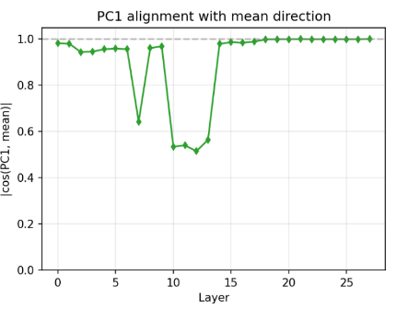
Is activation space super spiky?
At layer 14, PC1 and mean have ~0.98 cosine similarity
Yet, perturbing along mean looks random, perturbing along PC1 looks like feature!!

Slide 30
Steering behavior of PC1, MELBO_1, Mean
Surprisingly, not that different?
Steering along these directions produces the expected change - model switches between English and Mandarin
slightly easier (less magnitude required) with MELBO_1, but not a big difference
Preliminary and qualitative; needs more work
Strikes me as unexpected? I would expect steering along the mean direction to require much more magnitude to work?

Slide 31
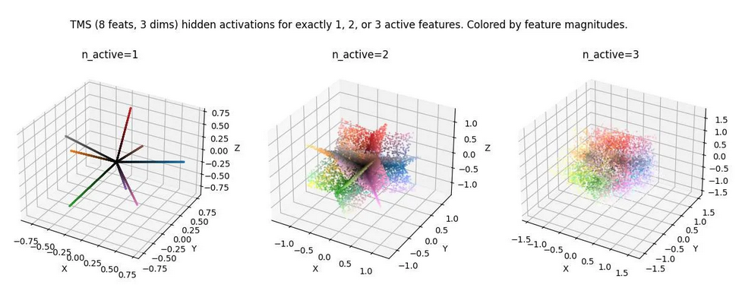
Is activation space super spiky? People think so!
Stolen from Stefan's LessWrong
These results support this picture, I think? And that PC1/MELBO_1 is a feature?

Slide 32
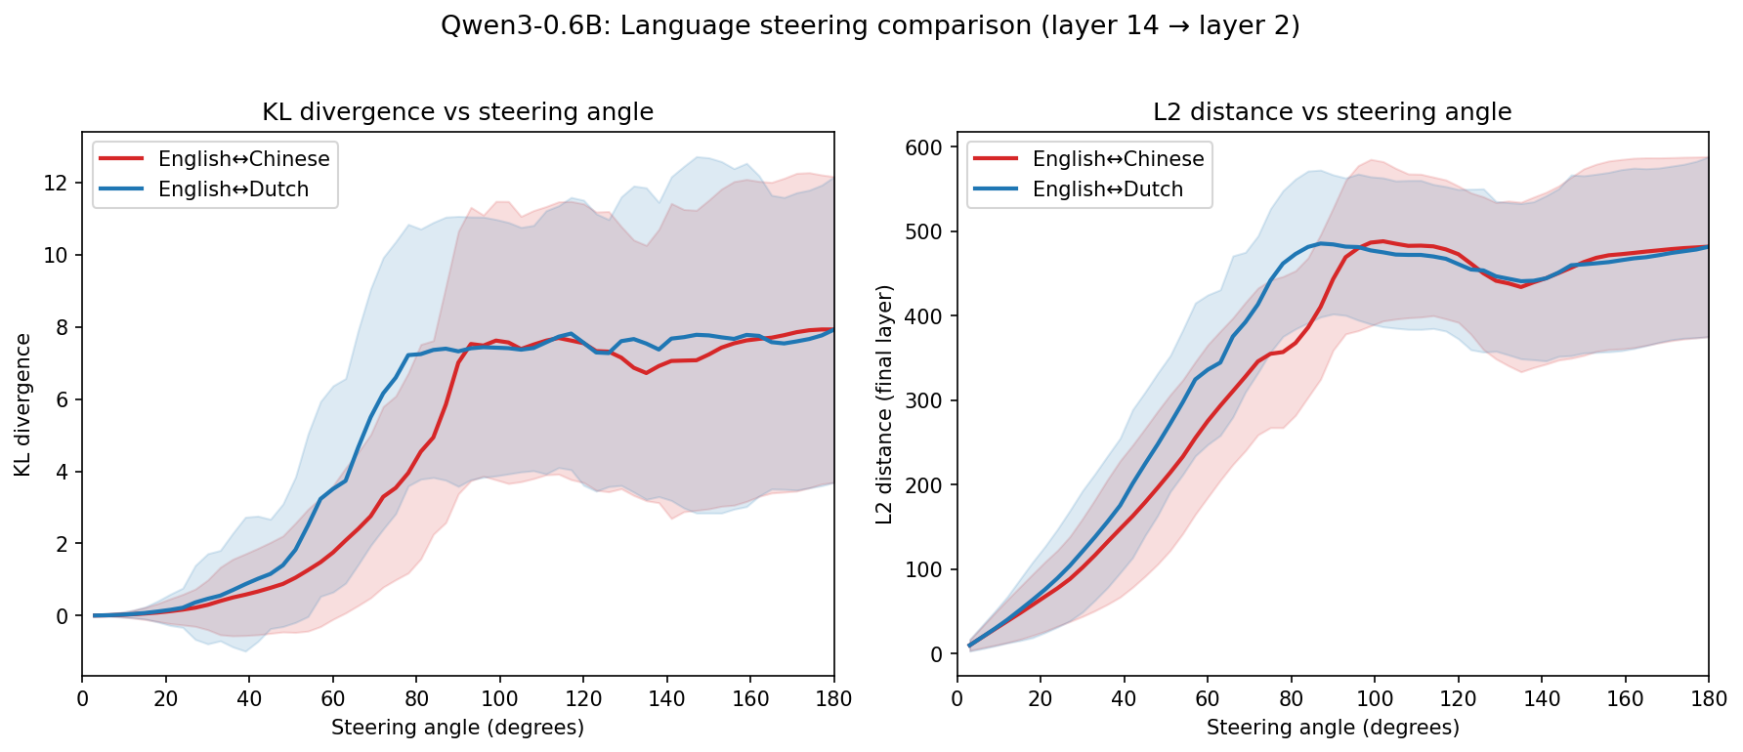
Short aside: similar behavior with different languages
I was worried that steering looking random had to do with English and Mandarin being very different -> hence try closer languages
Looks similar? Dutch does respond 'more' but idk this is not an in-depth investigation

Slide 33
Questions and directions
Steering is autoregressive: activations change at each step, so the exact feature direction shifts
Hypothesis: Fixed directions (MELBO_1, PC1, mean) all point roughly right, so they average out and steer similarly despite very different single-shot perturbation behavior
Testable: does MELBO_1 still break the plateau on held-out activations? If yes, it's a globally special direction. If no, the single-shot result reflects activation-specific alignment, not a cleaner feature
If not globally special, testable prediction: for same 'steering magnitude budget', many small pushes (e.g., steer at every token generation) work better than few big pushes (e.g., steer 5x as strong every 5th token)
Quick test: steer with activation shift vector (first slide); does it do something interpretable?

Slide 34
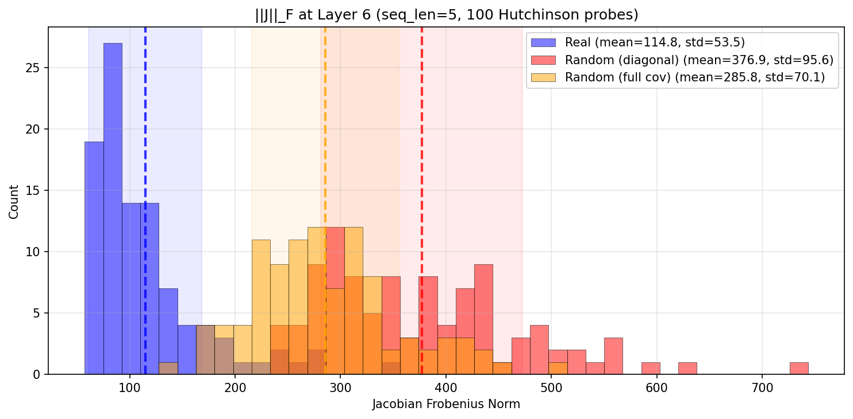
Meeting 10/02/2026 - Summary
Last time: Matching first two moments of Gaussian does not result in real-like activations
Up next: Can we optimize for vector that takes us from set of real activations to set of real-like activations, as measured by Jacobian norm distribution?

Slide 35
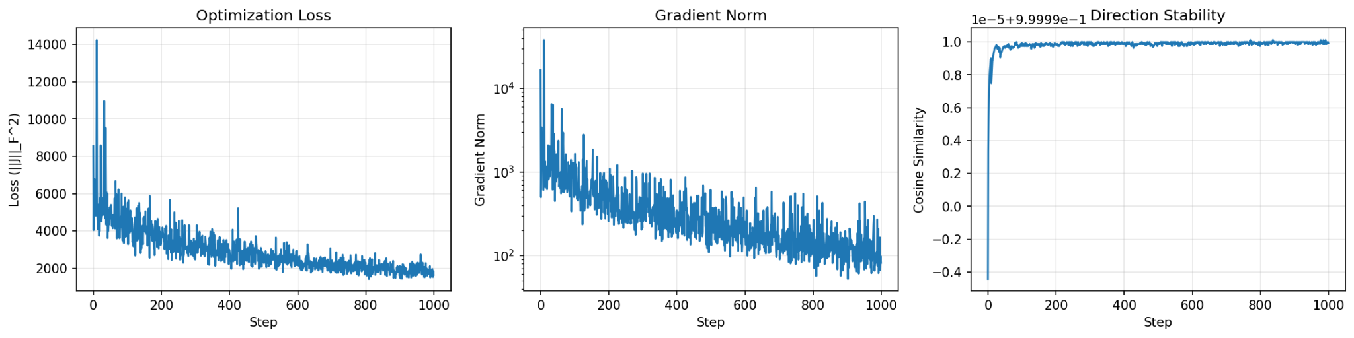
Yes! With a caveat…
Method:
Minimizing Jacobian of last layer activations w.r.t. Layer 6 activations, last-token only
Fix magnitude to mean inter-activation magnitude; optimize direction
Spot the mistake? :-) Wrong optimization target: we want real-like, _not_ smallest Jacobian
Std 34 -> 7

Slide 36
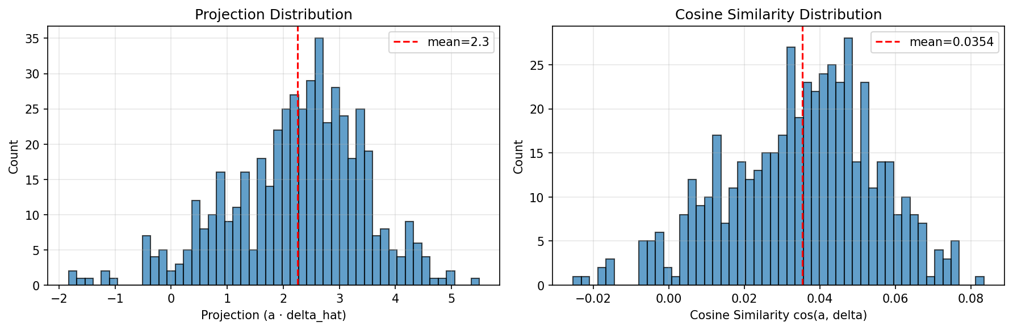
Does the resulting vector mean anything?
I'm not sure, but I don't think so. Are these even the right metrics? (This is over 100 real activations)

Slide 37
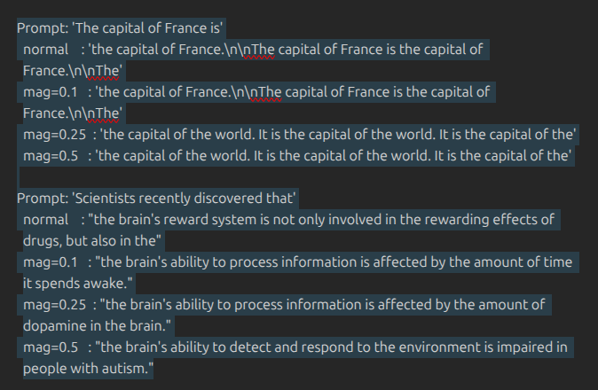
Does the resulting vector mean anything?
I'm not sure, but I don't think so. Some primitive steering:

Slide 38
Next steps and questions
Obvious next step: do the optimization with the right target :-)
  Potential 2nd next step: match also std of Jacobian norm distribution
  Potential nth next steps: optimize for other properties (directional?)
Q: Thoughts on methodology? Valuable to sweep for different values of magnitude?
  Trivial for small (stay in plateau); perhaps impossible at some point? Idk SGD strong
Q: Is 'does this (resulting) vector mean anything the right question'? What about 'what are these activations that we find?'?
Q: How to answer the above questions?
  Projections onto real activations?
  Steering-like experiments and look at output?
  Other things I haven't thought of?

